Slide 1

LANDING GEAR STRESS ANALYSIS
DEPARTMENT OF MECHANICAL ENGINEERING CV RAMAN GLOBAL UNIVERSITY, BHUBANESWAR
UNDER THE GUIDANCE OF
Dr. BIJAY. K. KHAMARI & Dr. RAHUL KUMAR
GROUP:- 15

Slide 2
Group Members:-
Sl No. | Name | Regn No | Email | Mobile No.
(1) | Mahesh Prajapati | 1801227749 | mahesh76947@gmail.com | 7605957165
(2) | Sumit Kumar | 1801227562 | sumitkarn1911@gmail.com | 7992201488
(3) | Navneet Arya | 1801227295 | navneetarya171@gmail.com | 7004338734
(4) | Royal Kumar Patel | 1801227410 | rouyalpatel123@gmail.com | 7325903342
(5) | Udaya Nath Gour | 1801227605 | Udayanathgour@gmail.com | 9178689748
(6) | Shantanu Srivastava | 1801227467 | srivastavashantanu70@gmail.com | 9709861620
(7) | Shashank Yash | 1801227471 | Shashankyash1229@gamil.com | 8340242924
Group Member:-

Slide 3
Content:-
Sl No | Particulars | Slide No.
1 | Introduction | 03
2 | Flow Chart | 04
3 | Literature Review | 05-07
4 | Objective | 08
5 | Material Selection | 09
6 | Parts of landing Gear | 10
7 | Geometry of Landing Gear | 11
8 | Dimensions of Landing Gear Parts in 2D | 12
9 | Meshing of Landing Gear | 13
10 | Experimental Results | 14
11 | Observation Table | 22
12 | Conclusion | 15
 | Future Work | 24
 | Refrence | 25

Slide 4
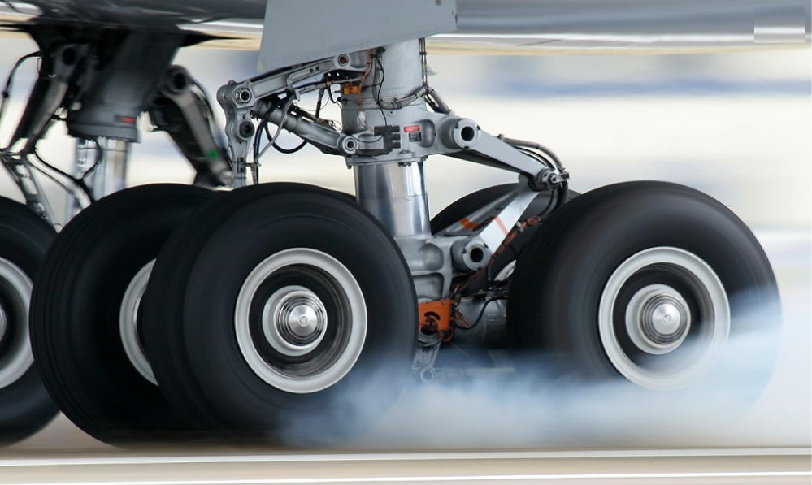
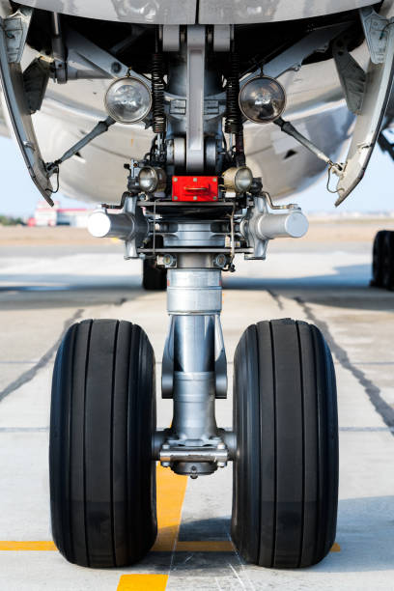
Introduction
Landing gear is a critical part & has significant effect on aircraft performance.
The basic function is to support aircraft, absorb & dissipate impact kinetic energy.
Early build airplanes conventionally used metal skids as landing gear .
It is able to supports the airplane weight but is not able to absorb the landing shock.
Oleo Pneumatic shock absorber is selected for high efficiency as they can absorb & remove vertical kinetic energy simultaneously.
Composites are being increasingly used due to weight saving ,reduction in fabrication cost, specific stiffness & strength properties

Slide 5
Literature Review:-
Sl.No | Title | Journal name | Author(s) | Year | Remark(s)
(1) | Stress Analysis On Composite Strut Landing Gear During Rough Landing | Transactions on Innovations in Science & TechnologyVolume.2, pp.46-51 | Sujith Stephen, Nithin S Nair, J. V. Muruga Lal Jeyan | 2016 | Composite material, Landing gear design, rough landing
(2) | Structural Analysis of Aircraft Landing Gear During Rough Landing | International Journal of Engineering Trends and Technology (IJETT) Volume-41 Number-5 | E. Dileep, L. Oblisamy, R. S. Krithiga, Jolly Jacob | 2016 | To develop a landing gear which is suitable for rough landing too
(3) | Aircraft Landing Gear Design and Development | How advanced technogies are helping to meet the challenges Infosys | Dr Ravi Kumar, Divakaran V.N, Srinivasa Rao Patnala | 2015 | Main aim to design landing gear with minimum weight, minimum volume, high performance

Slide 6
Literature Review Contd…:-
Sl.no | Title | Journal name | Author(s) | Year | Remark(s)
(4) | Aircraft Landing Gear Dynamics, simulation and control | Structural and multidisciplinary optimazation | W. kruger, I. Bessselink, D. Cowling, D. B. Doan, W. Kortum & W. Krabacher | 2007 | Aircraft weight, Operation Includes takeoff, taxing and towing, numerical simulation and shimmy problems
(5) | Overview of Landing Gear Dynamics | NASA Langley Research Centre, | Jocelyn Pritchard | 2012 | Self-Induced Oscillation, Brake-Induced Vibration, Low torsional stiffness, Wheel imbalance, Worn Parts
(6) | Step Towards Safety: Material Failure Analysis Of landing Gear |  | Aditya Armaan, Sharma Keshav, Srinivas G. | 2018 | Fatigue Failure, Material, Fractography, Landing Gear, Struts, Trunnions

Slide 7
Objective:-
Prepare the CAD model of every parts and assembled
Import IGES file into the Ansys
Selection of material for the assembled landing gear.
Simulation and analysis of the assembled landing gear.

Slide 8
Flow Chart:-
Material Selection
Modeling of Geometry
Drafting & Dimension
Meshing
Stimulation & Problem
Analysis of Result

Slide 9
Material Selection:-
Aircraft materials are of high specific strength, and corrosion-resistant alloys
Material used for the component on the landing gear are composed of mainly High Strength Steel (HSS),Titanium , Aluminium and Magnesium.
High strength steel – It have high strength and stiffness. It has high strength to volume ratio which is the main factor for the landing gear.
Titanium - It has high strength and low density used for weight saving .The main titanium alloy Ti-5Al-5V-5Mo-3Cr,which is used for as a main component for the landing gear.
Aluminium - Modern aircraft consist of approximatly 70% of Aluminium alloys.it has relatively low cost, light weight and can heat treated to strength level. Basically aluminum 7075 is used for the landing gear as it is strong with strength comparable to many material.
Mainly carbon fiber, glass fiber and epoxy resin composites are used for landing strut.

Slide 10
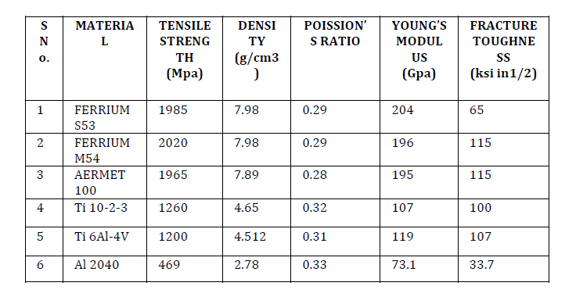
Material Selection Contd:-

Slide 11
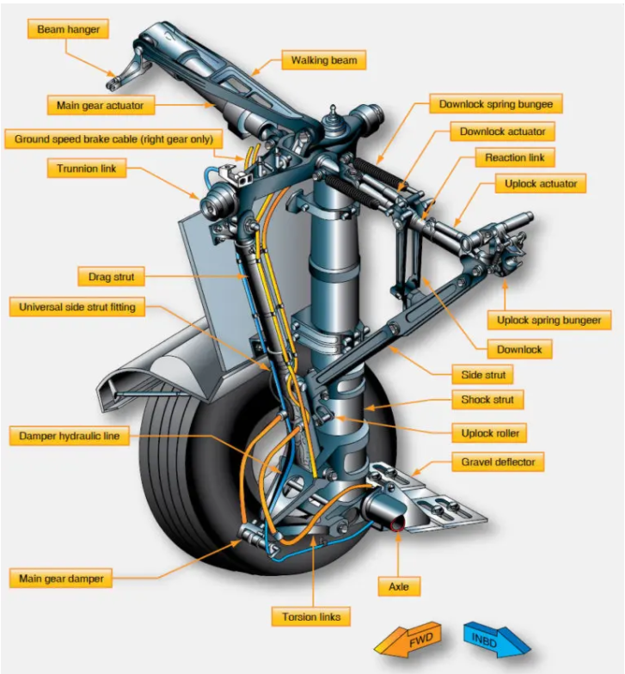
Parts of Landing Gear

Slide 12
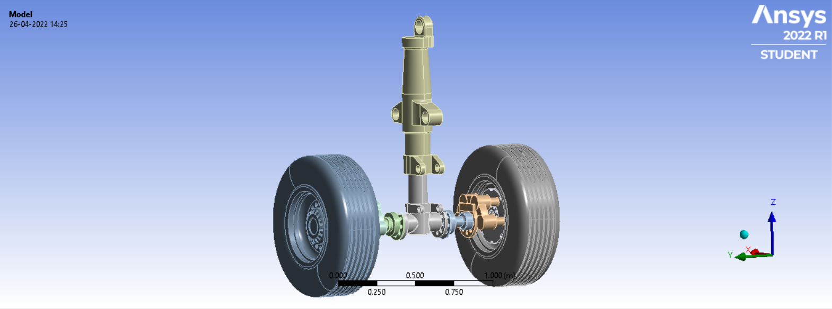
Geometry of Landing Gear:-

Slide 13
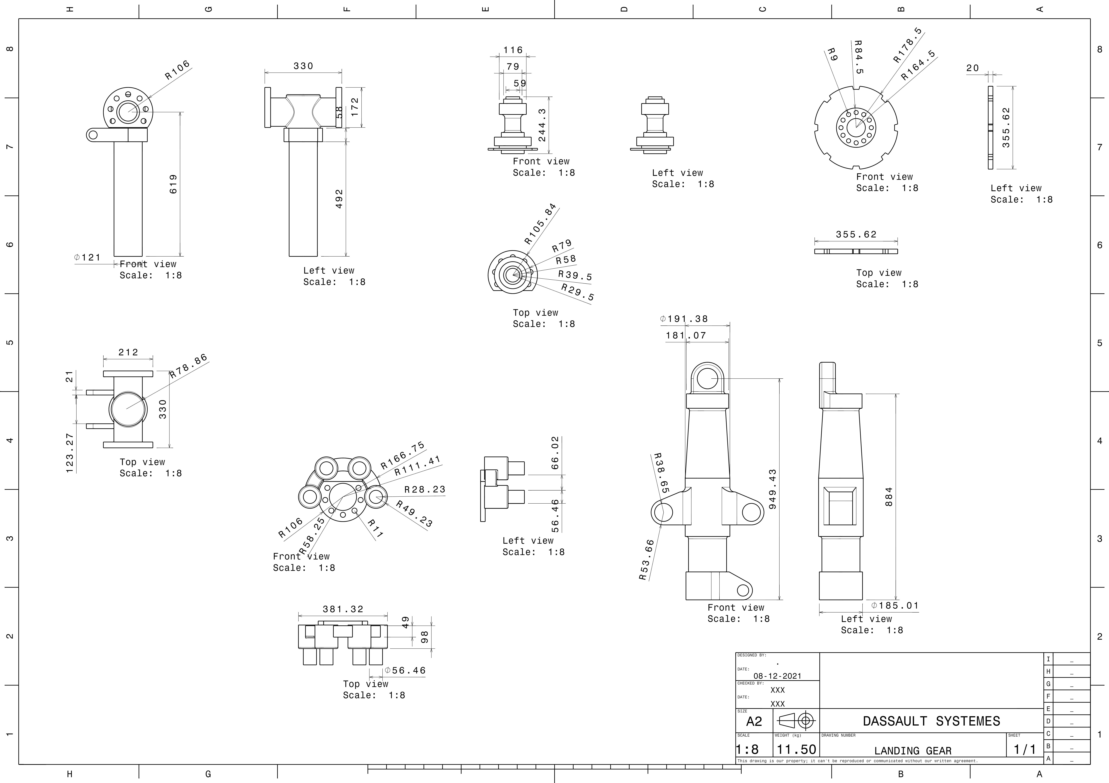
Dimensions of Landing Gear Parts in 2D..

Slide 14
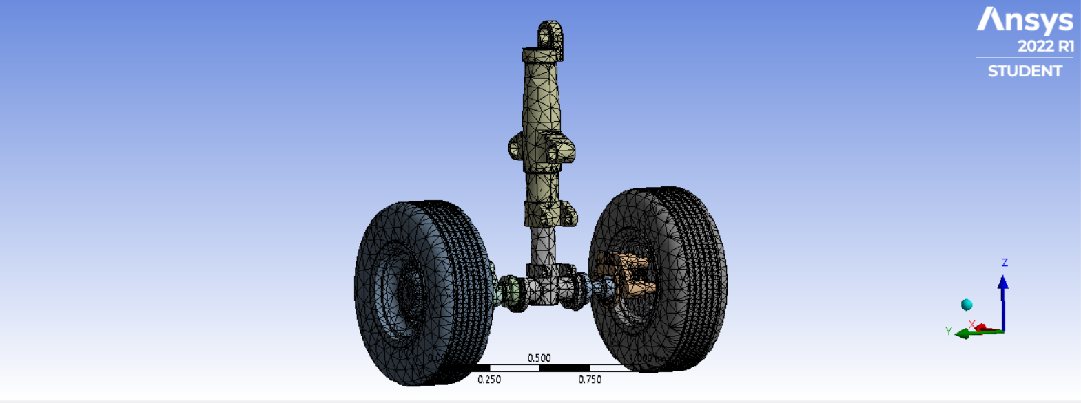
Meshing of Landing Gear

Slide 15
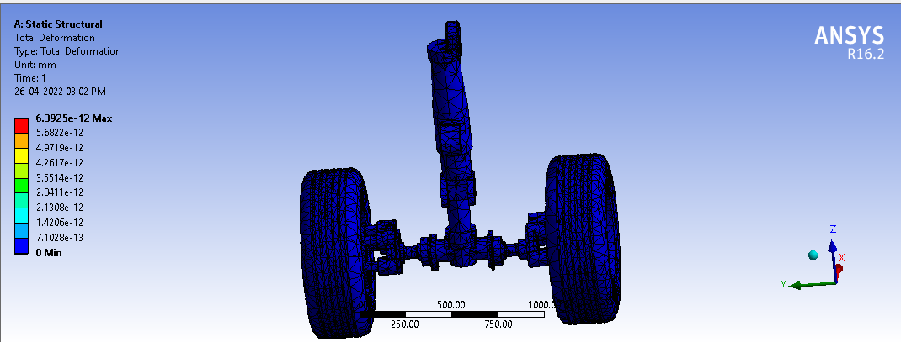
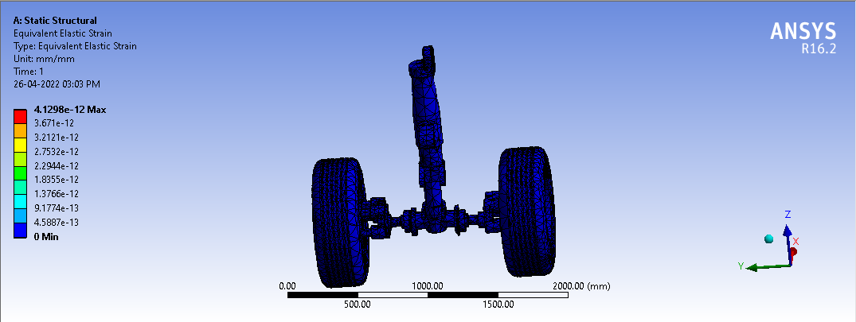
EXPERIMENTAL RESULTS
Analysis of Titaninum Alloy ( Ti-10V-2FE-3Al )
Total Deformation Result
Elastic Strain Result

Slide 16
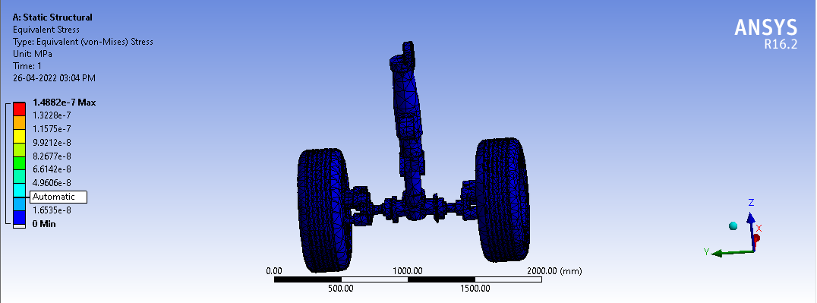
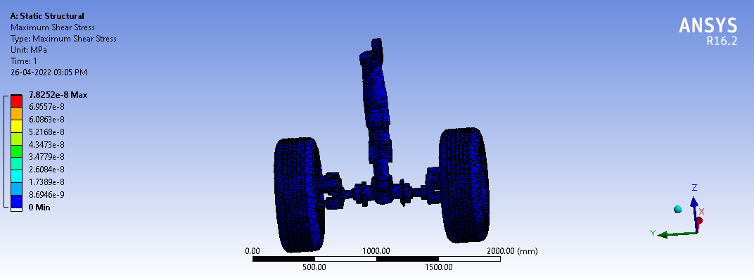
EXPERIMENTAL RESULTS Contd:-
Analysis of Titaninum Alloy ( Ti-10V-2FE-3Al ) Contd:-
Equivalent Elastic Strain (Von Mises) Results
Maximum Shear Stress Results

Slide 17
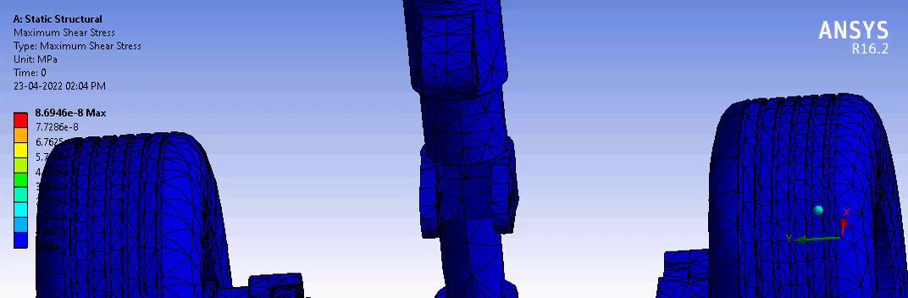

Slide 18
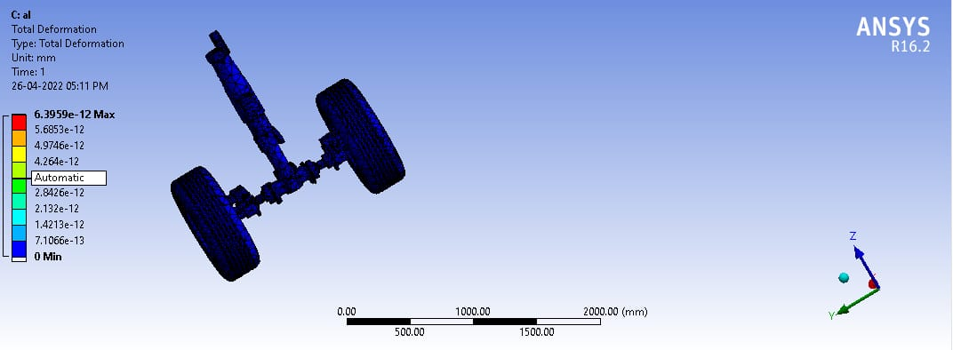

EXPERIMENTAL RESULTS
Analysis of Aluminium Alloy (Al 2040)
Total Deformation
Elastic Strain Result

Slide 19

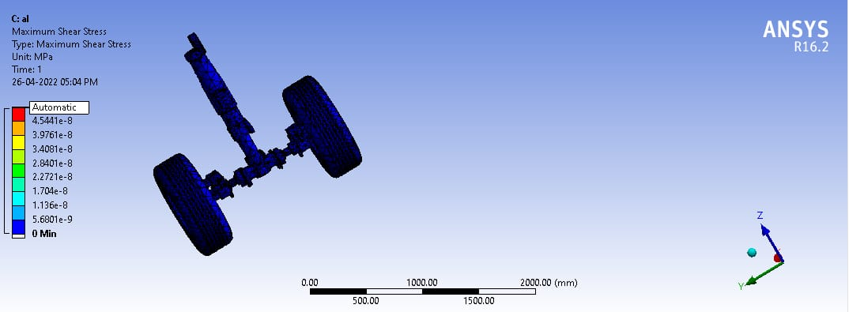
EXPERIMENTAL RESULTS
Analysis of Aluminium Alloy (Al 2040)
Equivalent Elastic Strain (Von Mises) Results
Maximum Shear Stress Results

Slide 20
EXPERIMENTAL RESULTS
19
Analysis of Titaninum Metal( Ti Metal)
Total Deformation
Elastic Strain Result

Slide 21
EXPERIMENTAL RESULTS
Analysis of Titaninum Metal( Ti Metal) contd:-
Equivalent Elastic Strain (Von Mises) Results
Maximum Shear Stress Results

Slide 22
Observation Table
Material | Total Deformation (mm) | Elastic Strain | Equivalent Elastic Strain (Von Mises) (Mpa) | Maximum Shear Stress (Mpa)
Titaninum Alloy ( Ti-10V-2FE-3Al ) | Max- 6.932 | Max- 4.218 | Max- 1.4882 | Max- 7.825
Aluminium Alloy (Al 2040) | Max- 6.392 | Max- 4.098 | Max- 9.472 | Max- 6.492
Titaninum Metal( Ti Metal) | Max-6.352 | Max- 4.129 | Max- 1.4882 | Max- 7.825

Slide 23
Conclusion
The CAD model is considered to be structural analysis by finite element approach using the ANSYS package. The accuracy and precession depend on the mesh quality.
A single material should not be used for every component as the role of every component is different.
Titanium alloy is selected as the highest deformation is seen their and a good stiff material is needed to reduce deformation though steel alloy has lesser deformation .
Maximum total deformation was observed in titaninum alloy(Ti-10v-2FE-3Al)
Maximum elastic strain was found in titaninum alloy(Ti-10v-2FE-3Al)

Slide 24
FUTURE WORK
Non-linear, fatigue and impact analysis can also be done to know the phenomenon of the landing gear.
Hydraulics and tyres should be taken for best results.
Some other materials can also be tested.
Topology optimization can also be done to reduce the weight and a combination of reduced weight design and steel alloy can probably do the job and can be made in less cost.

Slide 25
Reference
1.Hitch “ Aircraft ground dynamics. ” Vehicle System Dynamics , Vol 10 , 1981 , pp 319 – 332 . [Taylor & Francis Online], [Web of Science ®️], [Google Scholar]
2.von Schlippe und R. Dietrich “ Das Flattern eines pneumatischen Rades. ” Lilienthal Gesellschaft für Luftfahrtforschung , 1941 . [Google Scholar]
3.H. B. Pacejka “ Wheels ”. Farewell Address presented on May 22, 1996 at the Faculty of Mechanical Engineering and Marine Technology of the University of Technology , Delft , Netherlands . [Google Scholar]
4.G. Schänzer “ Meβ- und Regelungstechnik im Flugzeug ”. Automatisierungstechnische Praxis 36 , 1994 . [Google Scholar]
5.Roloff “ Landing Gear Integration on a Supersonic Transport Aircraft. ” In ICAS Proc. 96 - 4.11.1 , pp. 2659 – 2666 . [Google Scholar]
6.L. Pazmany “ Landing Gear Design for Light Aircraft ”. Vol I. ISBN 0-9616777-0-8 . [Google Scholar]

